Slide 1


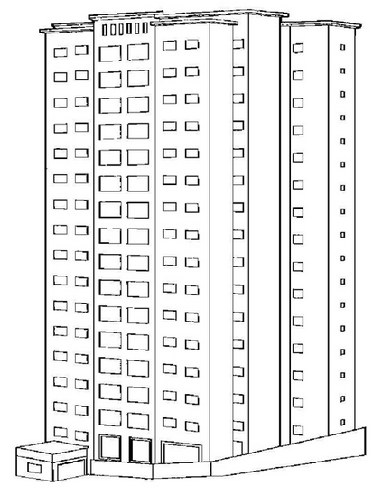

Função Posição do Corpo:
S(t) = 4,9t²
Tempo: t
Posição: s(t)
t = 0 s
0 m
t = 7 s
240,1 m
t = 15 s
1102,5 m
t = 19,16 s
1800 m

Slide 2
http://almirsuzana.blogspot.com.br/2011/04/predio-para-colorir.html
http://www.google.com.br/search?hl=pt-BR&site=imghp&tbm=isch&source=hp&biw=1440&bih=809&q=predio+desenho&oq=predio+desenho&gs_l=img.3..0.2053.4118.0.4285.14.12.0.2.2.1.215.1158.7j3j2.12.0...0.0...1ac.1.3.img.GHALNze-PAQ#hl=pt-BR&tbo=d&site=imghp&tbm=isch&sa=1&q=esfera&oq=esfera&gs_l=img.3..0l10.1272.3405.1.3598.7.7.0.0.0.0.409.956.3j3j4-1.7.0...0.0...1c.1.3.img.t643YcfRh48&bav=on.2,or.r_gc.r_pw.r_qf.&fp=cbe6b7843491699b&biw=1440&bih=809&imgrc=H4y-kcIhqmTIWM%3A%3B6ydtwUVnOLn6OM%3Bhttp%253A%252F%252F2.bp.blogspot.com%252F_0lbhTXgCV2Q%252FSSs-bIa8v2I%252FAAAAAAAAABc%252Fdr-E-D1yFRo%252Fs400%252Fesfera1.png%3Bhttp%253A%252F%252Fcatsegundao.blogspot.com%252F2008%252F11%252Fesfera-esfera-pode-ser-definida-como-um.html%3B250%3B250

